Slide 1
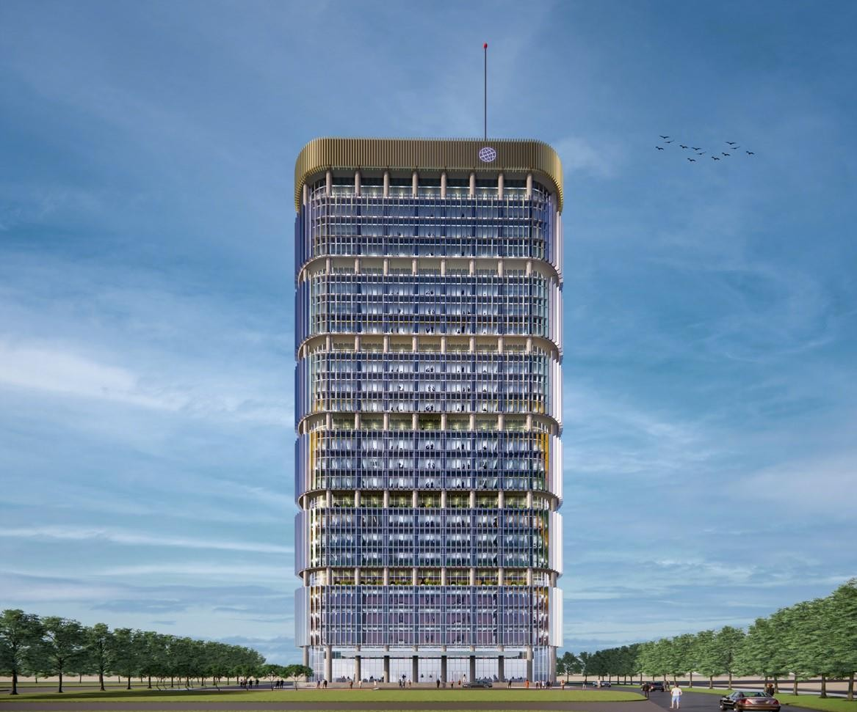


BATF Services@ GIFT IFSC - India’s Maiden International Financial Centre
International Financial Services Centres Authority
Ministry of Finance, Government of India GIFT City, Gujarat, India
www.ifsca.gov.in
1

Slide 2
Salient features of the Regulations
Government vide notification (CG-DL-E-19012024-251465) dated 18.01.2024 notified Bookkeeping, Accounting, Taxation and Financial Crime Compliance as a financial services.
Accounting Service
Book-Keeping Service
Taxation Services
Financial Crime Compliance
Preparation of financial statements
Compilation of financial statements from information provided by the client
Reviewing annual and interim financial statements or other accounting information
Analysis of financial statements;
Other related accounting support services
Classifying and recording transactions including payroll ledgers in terms of money or any other unit of measurement in books of account or other related documents.*
*Book-keeping Services under this clause do not include payroll and taxation services.
Tax Consultation
Tax Planning
Preparing and filing of tax returns of all kinds
Advice and guiding concerning taxes
Services rendered in relation to compliances of Anti-Money Laundering (AML) / Countering the Financing of Terrorism (CFT) measures and Financial Action Task Force (FATF) recommendations

Slide 3
Application and Granting of Registration
Application
Submit application in specified format with non-refundable fee.
Deficiencies
Applicants have 30 days to rectify deficiencies communicated by the Authority.
Granting
Authority may grant registration with specified conditions.
Validity
Registration is valid unless cancelled or surrendered with Authority approval.

Slide 4
Eligibility Conditions
1
2
3
Entity Structure
Jurisdiction
Service Receipt
Company or Limited Liability Partnership
Promoters must be from a jurisdiction not identified as "High Risk" by the FATF.
BATF services can be provided to any non-resident client*
*Except for jurisdictions which have been identified by FATF as High Risk Jurisdictions

Slide 5
Fit and Proper Requirements
Fairness and Integrity
Record of financial integrity, good reputation, and honesty.
No Convictions
Absence of convictions for offences involving moral turpitude or economic offences.
No Proceedings
No pending recovery proceedings initiated by a statutory body.
BATF Service Providers must ensure that the entity, its principal officer, directors, partners, key managerial personnel, and controlling shareholders are fit and proper persons at all times. The regulations also specify disqualifications, such as convictions for moral turpitude or economic offences, pending recovery proceedings, and orders from regulatory authorities.

Slide 6
Safeguarding Conditions
No Transfer
No transferring of existing contracts from Group Entities in India.
No Splitting
Business should not be set up by splitting, reconstructing, or reorganizing existing businesses in India.
Employees transfer
Upto 20% of employees in the BATF Service provider can be transferred from its Group Entities in India
Asset Requirement
There should not be any transfer of assets from any of the Group Entities in India to the BATF Service Provider

Slide 7
Key Managerial Personnel
Particulars | Principal Officer (PO) | Compliance Officer (CO)
Role | Responsible for overall activities in IFSC. | Responsible for reporting to the Board of Directors or head of the organization. Ensure compliance with policies, procedures, record maintenance, and regulation implementation.
Qualifications | Professional qualifications (CA, CS, CMA, CPA, CFA, or equivalent) or a postgraduate degree in finance, accountancy, business management, commerce, economics, taxation, or law from a recognized institution
 | If providing Financial Crime Compliance Services:, the PO shall hold relevant qualifications in financial crime compliance. | -
Min experience Ex. | 5 years | 3 years

Slide 8
Miscellaneous Provisions
Minimum office space criteria
  Minimum carpet area computed at 60 sq. ft. per employee.
Currency of Operations
  Carry out its operation in any Specified Foreign Currency.
  INR for routine administrative & statutory expenses.
  Balance Sheet in Specified Foreign Currency
Reporting requirements
  Entities must furnish information relating to their operations to the Authority and submit a compliance certificate issued by an independent third party within 90 days of each financial year's closure.

Slide 9
BATF Fee Structure
Application fees
Registration Fees
Annual Fees
Processing fees
USD 5000 (per activity)
< 500 employees : USD 5000 (per activity)
500-1000 employees : USD 7500 (per activity)
>1000 employees : USD 10000 (per activity)
USD 1000 (per activity)
Modification of terms and conditions : 20% of Registration fee
Relaxation/waiver : USD 1000

Slide 10
Key Advantages for BATF Service Provider
Tax efficiency
10 year tax holiday
Zero rated tax on export of services
Customs Exemption for goods and services imported in SEZ
GST benefits
Gujarat IT/ITes Policy and GCC Policy
Capex Support*
Opex Support**
Employee generation incentive
Talent Advantage
Gujarat and neighbouring states have high CA, CS, CWA talent
Knowledge corridor around GIFT City- Deakin University, UoW, IIFT, IIM-Ahmedabad, IIT-Gandhinagar, Gujarat Technical University, Gujarat University, Ahmedabad University, MICA, etc.
Operate under a unified financial regulator, IFSCA
Enhance global appeal and attraction for BATF Services.
*support at the rate of 25% upto 50 Crore for the projects having gross fixed capital investment (GFCI) less than ₹250 crore.
** government will provide support of 15% up to Rs 20 crore. projects having gross fixed capital investment (GFCI) less than ₹250 crore will get opex support.

Slide 11





Current Status
23 Entities have been authorized as BATF Service Provider across permitted activities
Some of the key BATF Service Provider in GIFT IFSC are

Slide 12
Thank You !
For any further query feel free to contact the following officials
Kalpesh Mehta(AGM) : kalpesh.mehta@ifsca.gov.in
Harish Jhajharia(AM) : harish.jhajharia@ifsca.gov.in

